Slide 1
SEZG651/ SSZG653
Software Architectures
Module 5
CS08 Conformance Testing Reconstruction

Slide 2
Software Architecture
Module 5
Ensuring conformance to architecture
Harvinder S Jabbal
SEZG651/SSZG653 Software Architectures

Slide 3
Code may drift away from Architecture
Examples of drift:
Not sticking to the discipline of layers – an object in one layer calling an object located in a layer beyond the adjacent layer
Accessing data base directly without going through data access layer
Notifying different modules one by one instead of using ‘publish – subscribe’ model,
Not making use of a common logging mechanism, etc.
What other architecture violations have you come across?

Slide 4
Techniques to keep the code and architecture consistent
Embed design concepts in the code (Architecturally evident coding style)
Use frameworks
Use code templates
Update architecture documentation

Slide 5
Embed design in code
Follow ‘Architecturally Evident Coding Style’
Indicate in the code, aspects of architecture being implemented. Example:
  If we are using a layered architecture, indicate to which layer the code belongs
  If we are using ‘Publish – Subscribe’ pattern, indicate in the code whether it belongs to Publisher or Subscriber
  If we are using Message queues (MQ) for communication between components, indicate what the component is doing - inserting message or retrieving message from the MQ.

Slide 6
Use Frameworks
Examples of frameworks:
Spring
Hibernate
Autosar - AUTomotive Open System Architecture

Slide 7
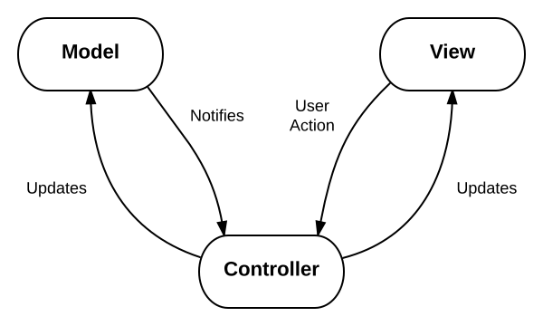
Spring MVC Framework
Supports Model-View-Controller framework
Here code belongs to one of the 3 component types - Model, View or Controller
  Model encapsulates the application data
  View renders screens on browser
  Controller processes user requests, interacts with Model components and passes information to View components for rendering

Slide 8
Experience sharing
Can you give examples of other frameworks that you have used?

Slide 9
Other examples of frameworks
Publish – Subscribe framework (JMS)
Workflow framework of SalesForce.com
Rules engine (DROOLS)
Logging framework - Log4J (for logging events)

Slide 10
Use Code templates
A template provides a structure for developers to code
For example a template for developing a code that needs to be fault tolerant will have the following sections in the template
    Get event
    Case (Event type)
      Normal: // received by primary process
        Process X; Send state to backup process;
        Process Y; Send state to backup process;
      Update State data: // received by Backup process
        Update state data;
      Switch over: // received by Backup process
        Notify clients about change in Primary process;
    End case;
Code needs to be accommodated in this template

Slide 11
Update architecture documentation
Changes to code should be accompanied with changes to architecture document when applicable
At least mark parts of the arch document that is no longer applicable as ‘No longer applicable’. This increases trust on remainder of the document
Technique: At release time, synchronize the arch doc with code.

Slide 12
Exercise
What other techniques can we think of to ensure that code does not drift away from architecture?

Slide 13
Exercise
What other techniques can we think of to ensure that code does not drift away from architecture?
  Educate new team members about the architecture
  Do Code reviews
  Create folders for each architectural aspect such as layer, service, UI, external interfaces, etc. and follow a discipline of storing the code in respective folders

Slide 14
Software Architecture
Module 5
Architecture & testing
Harvinder S Jabbal
SEZG651/SSZG653 Software Architectures

Slide 15
Architecture & testing
How does architecture help in testing activities?

Slide 16
Architecture & testing
Arch helps prioritize test cases based on ASRs
Architecture can help in creation of integration test plan
Architecture needs to be designed to support testability requirements

Slide 17
Architecture & testing
Arch helps prioritize test cases based on ASRs
What work product of architecture design can we use to prioritize the test cases?

Slide 18
What work product of architecture design can we use to prioritize the test cases?
Utility tree can be used to identify high priority scenarios (high on business value and high on architectural impact) which will translate into high priority test cases

Slide 19
Architecture & testing
Architecture can help in creation of integration test plan
How?

Slide 20
Architecture & testing
Architecture can help in creation of integration test plan
How?
Architecture tells us what modules interact with each other
Architecture tells us which modules depend on which other modules.
This helps us identify integration test cases and identify modules needed for integration testing

Slide 21
Architecture & testing
Architecture needs to be designed to support testability requirements such as
  Ability to switch data sources (Test data & Production data)
  Roll back changes made by test cases (to restore system to original state, so that we can execute more test cases later)
  Ability to replace components (simulators of payment gateway, sensors, external systems such as Aadhar system)

Slide 22
Experience sharing
Can you describe how your architect helped the testing team?

Slide 23
Software Architecture
Module 5
Architecture Reconstruction
Harvinder S Jabbal
SEZG651/SSZG653 Software Architectures

Slide 24
Contents
Purpose of architecture reconstruction
Architecture reconstruction technique
Reconstruction tools.

Slide 25
Purpose of architecture reconstruction
To understand the architecture of a system for which no documentation exists
To migrate a system from old technology to new. Ex. Mainframe to Web
To identify reusable components in a system, such as logging component, security component, etc.

Slide 26
Phases of architecture reconstruction
Identify components and their relationship (using a tool)
Aggregate components into abstract components (specify grouping to tool)
Analyse the architecture (tool displays architecture)

Slide 27
Identify components & their relationship
Extract information from
  Source code
  Execution traces
  Build scripts
  Etc.
This gets info such as
  classes
  file they use
  ‘Caller – callee’ relationship
  global data accessed by different objects

Slide 28
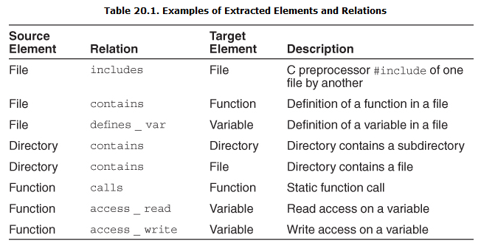
Examples of component extraction
Ref: Text book: Software Arch in practice by Len Bass and others

Slide 29
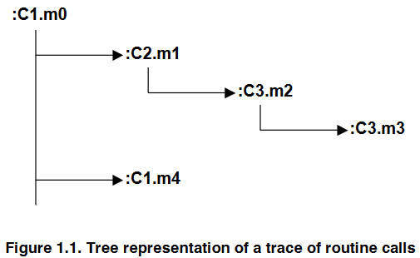
Execution trace of method calls
Ref: Techniques to Simplify the Analysis of Execution Traces for Program Comprehension by Abdelwahab Hamou-Lhadj
https://pdfs.semanticscholar.org/3db0/dd1980586c0a9d489e4b94c2996f117df2d5.pdf

Slide 30
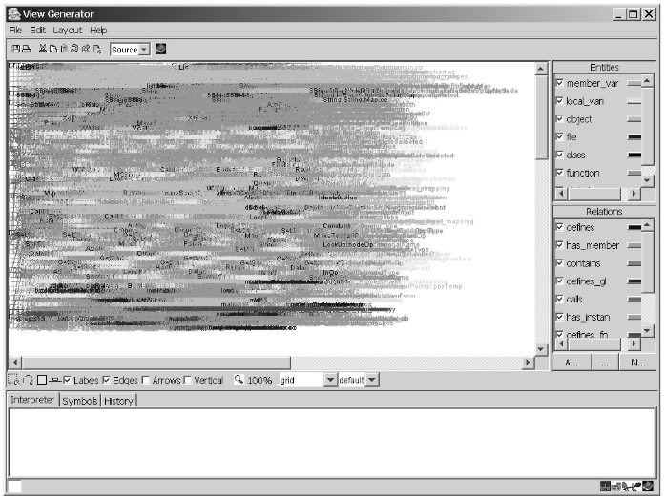
Case study: ‘Vanish’ System
Tool used for reconstruction: ARMIN
(ARchitecture Reconstruction and MINing)
White-Noise” View Showing All of the Elements and Relations
Ref: https://resources.sei.cmu.edu/asset_files/TechnicalNote/2003_004_001_14141.pdf

Slide 31
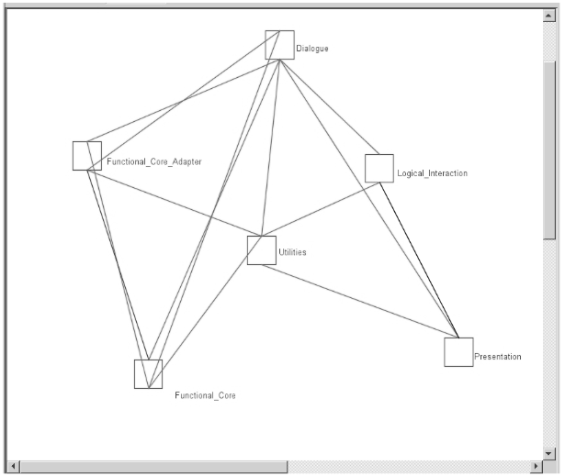
Case study: ‘Vanish’ System
Architecture view after aggregation of components
One can take help of the technical team to get a broad understanding of the system, before starting the aggregation exercise

Slide 32
Case study: ‘Vanish’ System
Analyse architecture
One can notice that the architecture of ‘Vanish’ is not strictly layered

Slide 33
Tools
Dali, ARMIN, Lattix, Sonar J, Structure 101
References:
https://resources.sei.cmu.edu/asset_files/TechnicalReport/2003_005_001_14081.pdf

Slide 34
Experience sharing
Were you involved in architecture reconstruction of an existing system?
How did you go about it?
What tools did you use?

Slide 35
Appendix

Slide 36
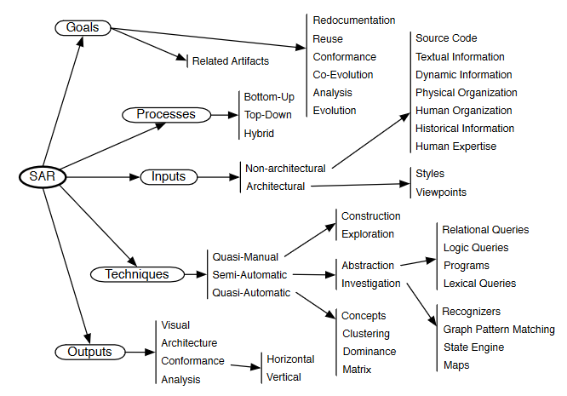
SAR: Sw Arch Reconstruction
Ref: https://rmod.inria.fr/archives/papers/Duca09c-TSE-SOAArchitectureExtraction.pdf

Slide 37
Phases of architecture reconstruction
Raw view extraction gets information from source code, execution traces and build scripts. It gets info such as classes, file / data they use, caller – callee relationship, global data accessed by different objects
DB construction: Putting extracted data into a common format
View fusion: Combines views of info stored in DB. Source code analysis gives a static view. If some objects are dynamically bound at run time then execution trace will provide this information. Then an expert may group the elements into a layer
Arch analysis: Validate the correctness of architecture elements obtained from view fusion phase. Ex. There could be restriction that a layer calls objects in adjacent layers only. Or all db access should be via an entity bean only
Iterate

Slide 38
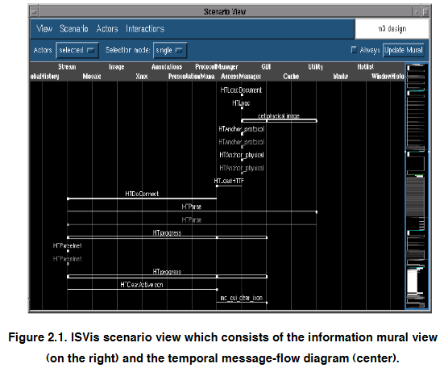

Slide 39
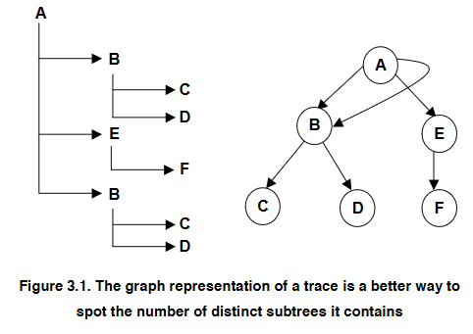
Ref: Techniques to Simplify the Analysis of Execution Traces for Program Comprehension by Abdelwahab Hamou-Lhadj
https://pdfs.semanticscholar.org/3db0/dd1980586c0a9d489e4b94c2996f117df2d5.pdf

Slide 40
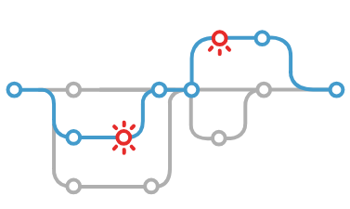
SonarCube Explores All Execution Paths
Issues
https://www.sonarqube.org/features/issues-tracking/

Slide 41
Group extracted components
Combines views of info stored in DB.
View 1: Source code analysis gives a static view.
View 2: If some objects are dynamically bound at run time then execution trace will provide this information.
View 3: Then an expert may group the elements into a layer
Combine all these views to form a consolidated view

Slide 42
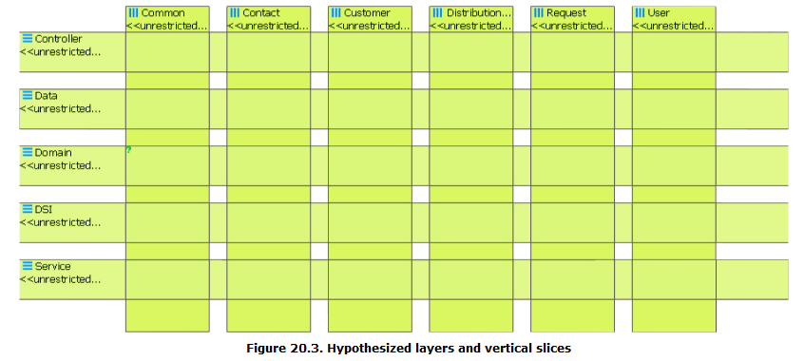
Sample View fusion using Sonar tool
Sonar tool allows definition of layers and vertical slices through the layers
The tool will populate the layers & slices with components / elements

Slide 43
Architecture analysis
Check conformance to architecture
Ex. There could be restriction that a layer calls objects in adjacent layers only. Or
Ex. All db access should be via an entity bean only

Slide 44
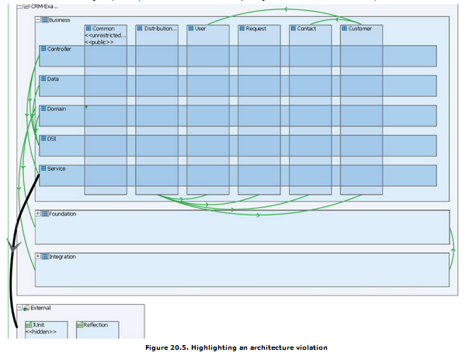
Example of violation of architecture (detected by Sonar)
No portion of the application should depend upon Junit. Based on this specification, Sonar detects the rule violation

Slide 45
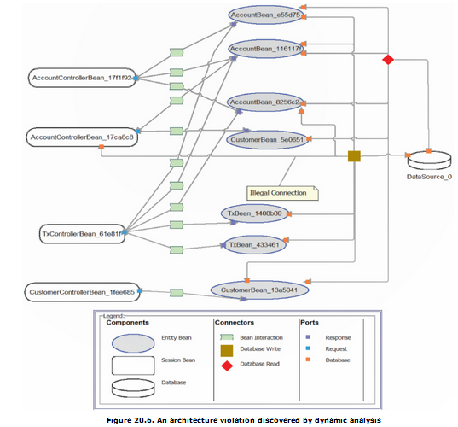
Example of architecture violation (detected by Sonar)
All database access is supposed to be managed by entity beans. Discovered by tool Disco Tect

